Slide 1
Unit 3: Text-Based Programming
Lesson 12

Slide 2
Conditional Loops
Previously, you learned how to make computers do the same thing a number of times using a for loop. But what if, when you start your loop, you don’t know how many times the computer will need to do it? Or what if you want to do something forever? In such cases, you can use a different type of loop which will keep doing the same action until told to stop. This is known as a conditional loop or while loop.

Slide 3
How Does a Conditional Loop Work?
At the start of the loop the computer will evaluate the condition (e.g. is this statement true), if so it will run the code inside the loop. The next time around the loop it will evaluate the condition again - if it’s still true it will run the code again, if it’s not true it will exit the loop and carry on running the rest of the program.

Slide 4
While Loops
Python uses a “while” loop to do conditional loops, and it works by following this process:
while this statement is true, I will continue to run this code, until it is false.
The syntax for a while loop in Python looks like this:
while statement == True: print("do this")

Slide 5
The syntax is very similar to an if: between the while and the : is the condition to be evaluated, and the code indented under it is the code to run as part of the loop.
Next you will create a small program which uses a while loop to continually ask the user to “guess my name” until they get it correct.
Create a new program and save it as “while”.
Use input to ask for a guess:

Slide 6
Now use a while loop which will run as long as the value in guess is not equal to your name.
Indented under the while, let the user know they got it wrong and tell them to “guess again”, updating the value of the guess variable.
Finally, at the end of your program and not indented under the while loop let the user know the got it correct.

Slide 7
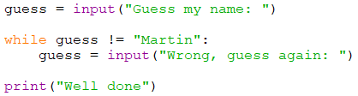
Your program should look similar to this.
Run your program and test the following scenarios:
guess the name correctly the first time.
get the name incorrectly once.
get the name incorrectly many times.

Slide 8
The following logic is applied when running this code:
When the name is guessed correctly the first time, the code inside the while loop is never run, because guess != "Martin" is false.
If the name is guessed incorrectly, the code inside the while loop is run and the variable guess is updated with the user’s next guess.
The while loop’s statement is then evaluated again. If now guess != "Martin" is true (i.e. the guess is still not ‘Martin’), then the code inside the loop will run again.
This continues until guess != "Martin" is false, i.e. until the user has finally guessed Martin. At this point, the program continues from after the while loop, and “well done” is printed.

Slide 9
Portfolio 8 – While Loop Counter
Change the program so that it keeps a count of the number of times it took you to guess the name, and then outputs the total when you guess correctly.
Save your file as your_name_u3_port_8

Slide 10

Do this forever
Using a while loop you can get a computer to continue to do the same task forever, known as an infinite loop. This special type of conditional loop can be really useful, but it’s also a really easy way to use up all of your computer’s processing power!
Create a new program, add this code, save it as infinite, and run it.
It doesn’t matter how many times you press the enter key, the program will keep running forever. It will never leave the while loop – it is infinite.
Tip: If you want to end an infinite program click the Stop button on Mu

Slide 11

while True: is the “usual” way of creating an infinite loop in Python and although it looks a bit strange, it makes sense when you understand what’s happening.
First consider this program:
The variable keep_running will always be equal to True and as it is never changed to False this program will run forever and is infinite.

Slide 12


If keep_running is always True the same program could be written as follows replacing the keep_running variable with True:
As you learned previously, if you were to evaluate True == True it will always be equal to True, so if you replace True == True with True and you end up with:
Reflect: In what sort of situations do you think an infinite loop might be useful?

Slide 13
Loop your Bot
You can use a conditional loop in your bot program so that it continues to ask “How can I help?” until you give it the command “bye”.
Open your bot 2 program.
At the top of your program create a variable called finished and set it to False. This variable will be set to True when the user enters the “bye” command.

Slide 14
After the welcome statement use a while loop to keep your program running as long as finished is equal to False.
The whole of your program should now be indented under the while loop.
Tip: you can indent multiple lines of code by selecting them in a block and pressing TAB.

Slide 15
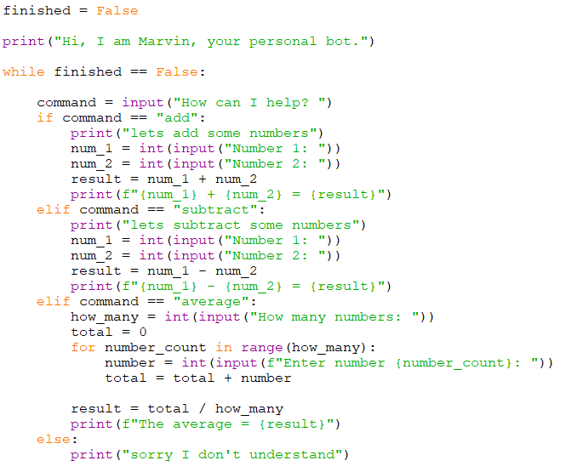

Slide 16

Your bot will now continue to ask “How can I help you” forever as the variable finished is always set to False. You should change your bot so that you can give it the command “bye” and the program will finish.
Using an elif add a new “bye” command, which sets finished to True.
The elif has to go before the else
Run your program and test that it continues to run until you enter the command “bye”.

Slide 17
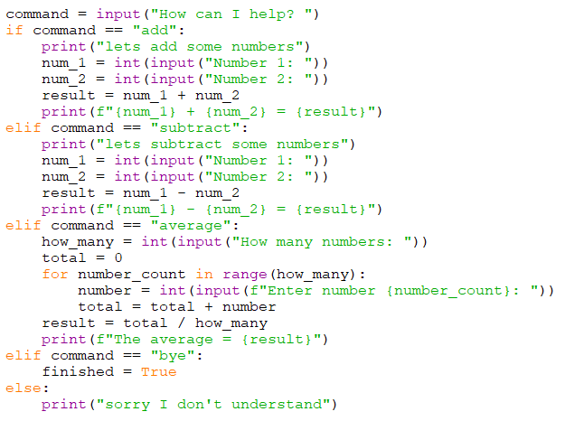
Inside your while loop should look like this

Slide 18
After the loop you can add a print statement to say goodbye.
It can not be indented, it should be inline with the while at the start of the loop
Run your program and make sure the ‘Goodbye’ only displays after you enter “bye”

